Slide 1
A Simple Implementation for Facial Skin Beautification
Yi Zhou
zhouyi1023@tju.edu.cn

Slide 2
Pipeline
Color Mask
Landmark Fitting
Mask Gneration
Detail Mask
Texture Mask
Face Detection
Sythesize
Smoothed Texture Layer
Intensity Layer
Edge Preserve
Smoothing
Convert to CIELab
Detail Layer
Color Layers

Slide 3
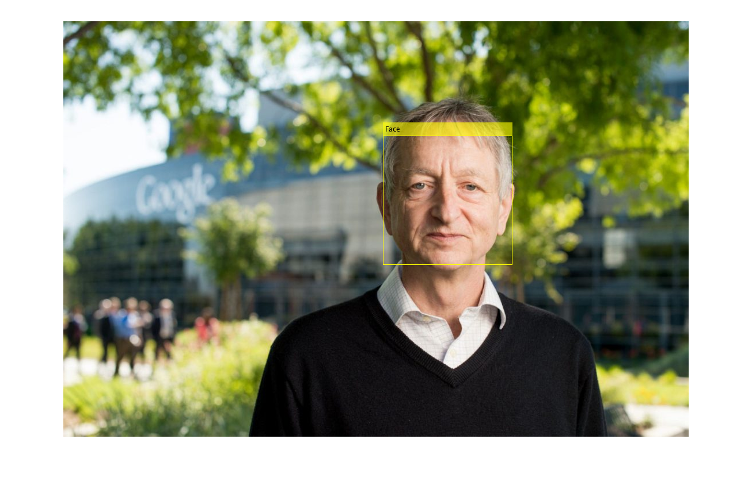
Face Detection
Viola Jones Face Detector
Matlab API
Picture from https://www.thestar.com/news/world/2015/04/17/how-a-toronto-professors-research-revolutionized-artificial-intelligence.html

Slide 4
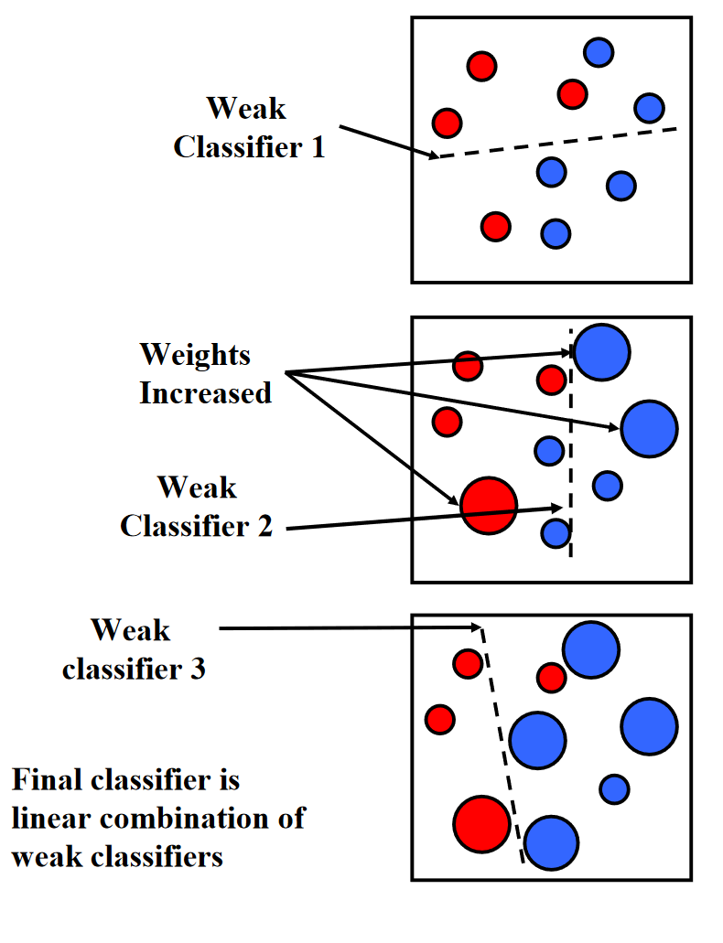
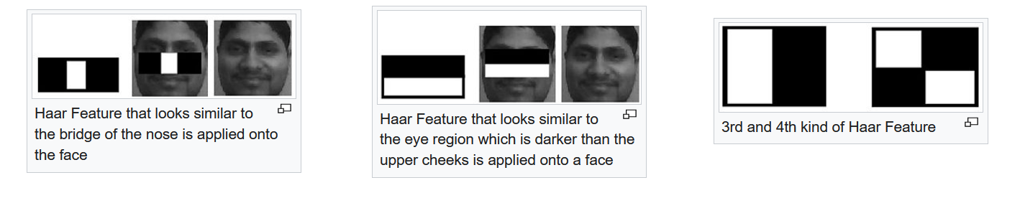
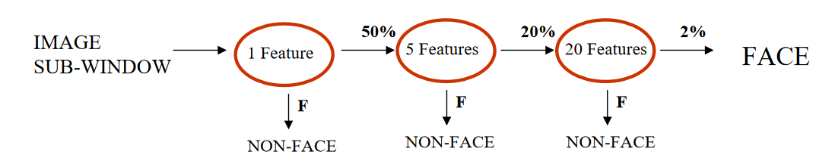
Viola Jones Face Detector
Harr Features + Adaboost + Cascade of Classifier

Slide 5

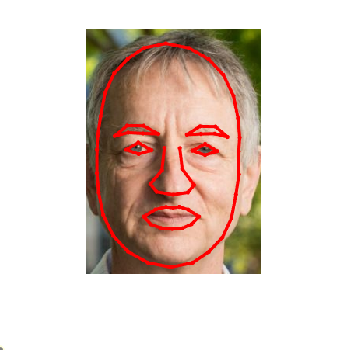
Landmark Fitting
Active Shape Model + MUCT 76 Landmarks for Faces
https://github.com/johnwmillr/ActiveShapeModels (However, this implementation is not stable)

Slide 6
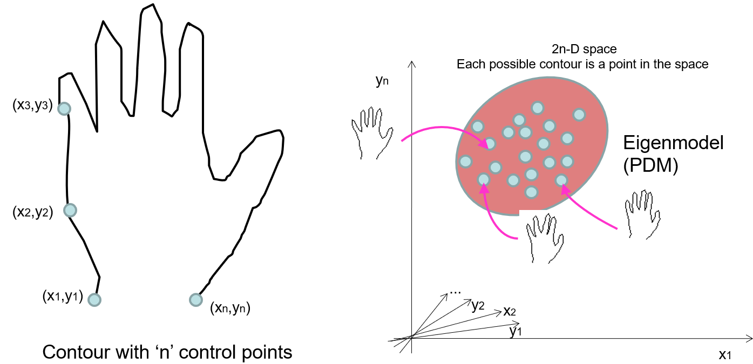
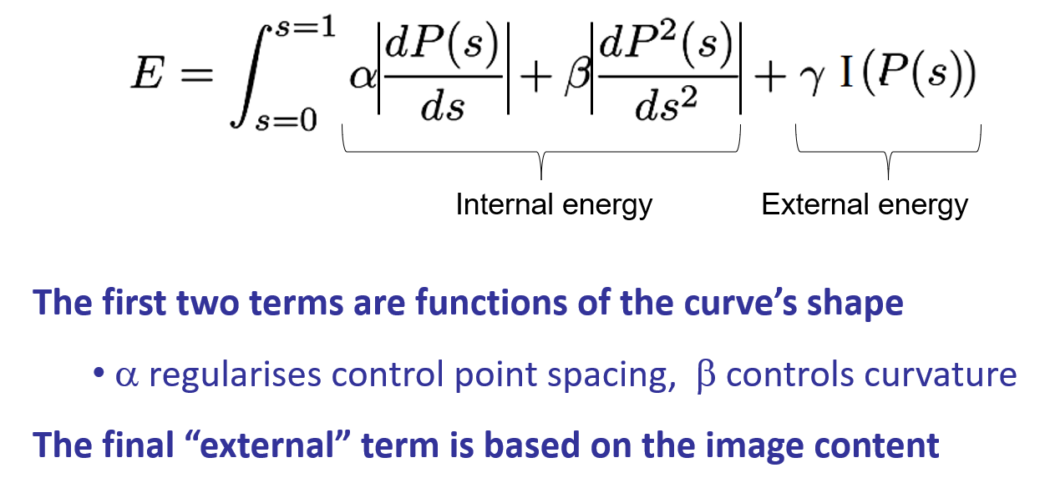
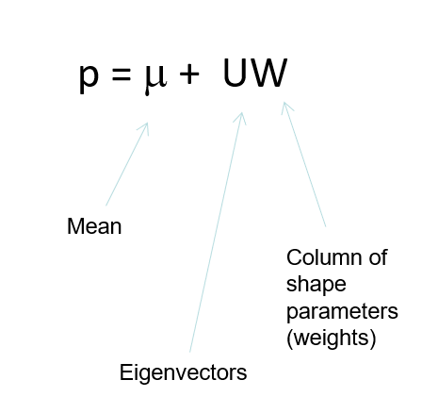
Active Shape Model
An active shape model (ASM) is an active contour (snake) where control point movement is governed by a PDM i.e. a statistical shape model.
Update translation, rotation, scaling and the shape parameters

Slide 7
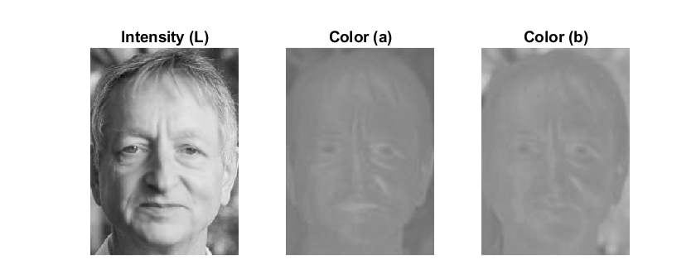
RGB to CIELab
L* for the lightness from black (0) to white (100)
a* from green (−) to red (+)
b* from blue (−) to yellow (+)

Slide 8
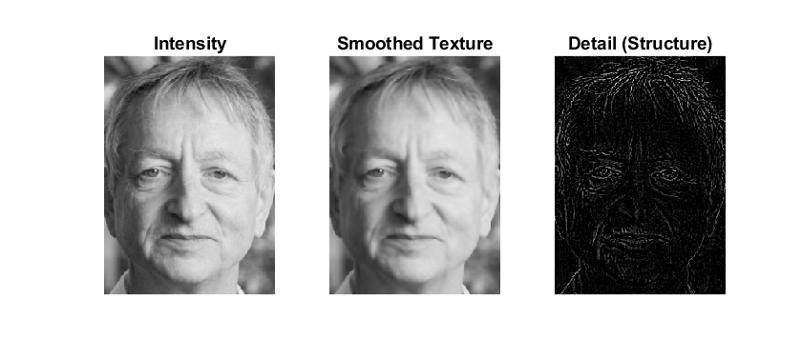
Edge Preserve Smoothing
anisotropic diffusion filter

Slide 9
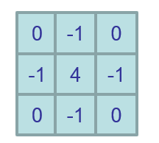
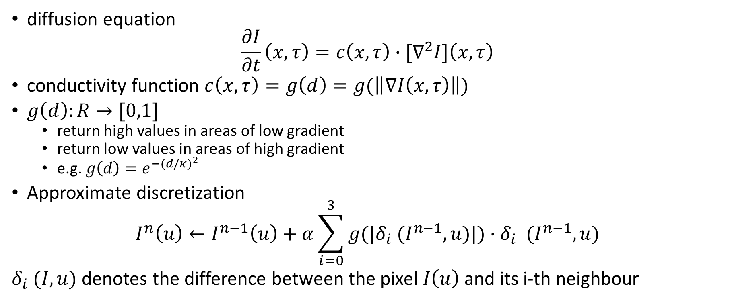
Perona-Malik Filter
diffusion equation
$$\frac{∂I}{∂t}\left(x,τ\right)=c\left(x,τ\right)∙[∇^{2}I]\left(x,τ\right)$$
conductivity function $c\left(x,τ\right)=g\left(d\right)=g(\left\|∇I\left(x,τ\right)\right\|)$
$g\left(d\right):R→[0,1]$
return high values in areas of low gradient
return low values in areas of high gradient
e.g. $g\left(d\right)=e^{−{(d/κ)}^{2}}$
Approximate discretization
$$I^{n}\left(u\right)←I^{n−1}\left(u\right)+α\sum_{i=0}^{3}{g(|δ_{i} (I^{n−1},u)|){∙δ}_{i} (I^{n−1},u)}$$
$δ_{i} (I,u)$ denotes the difference between the pixel $I\left(u\right)$ and its i-th neighbour
Laplacian

Slide 10
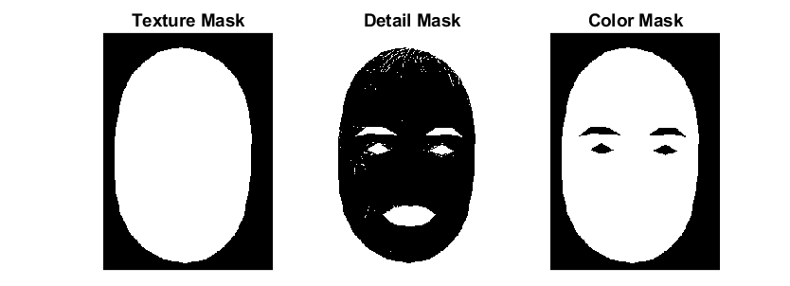
Mask Generation
Texture Mask: Select the facial region
Detail Mask: Retain eyes, eyebrows, lips and some significant details corresponding to hairs and eye structures
Color Mask: Select skin and lips

Slide 11
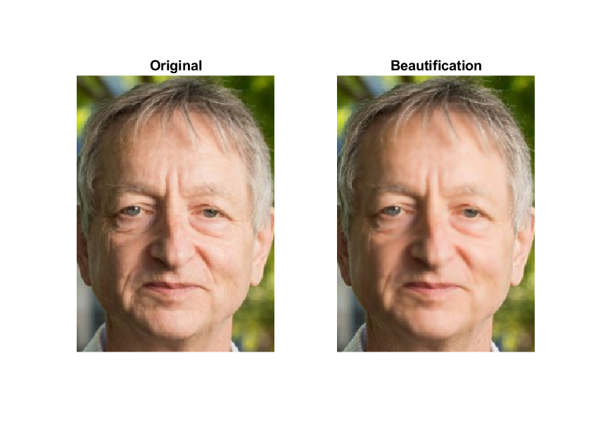
Synthesize
Color Enhancement
Texture Smoothing
Detail Selection

Slide 12
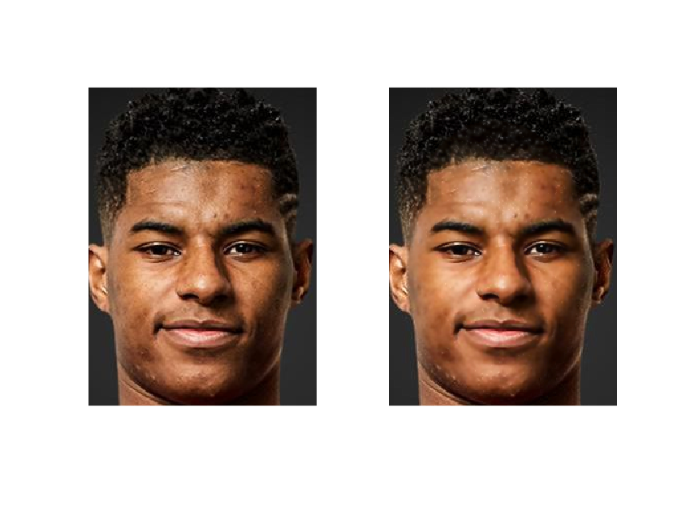
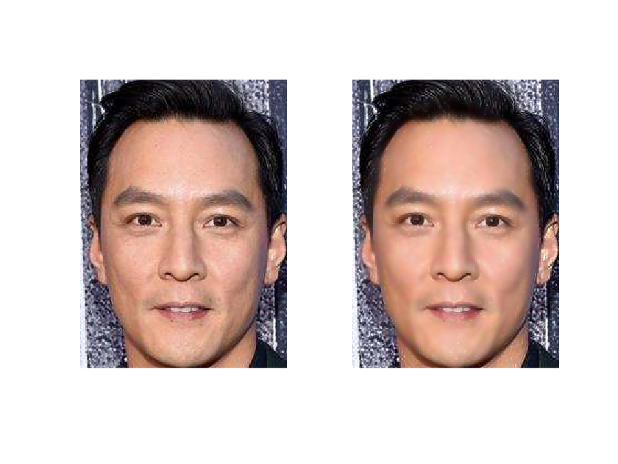
Other Examples

Slide 13
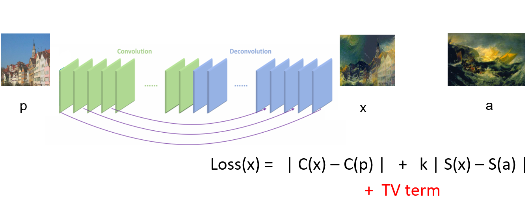
Further Considerations
Subjective Judgements
Learn from User Preferences
End2End Method, e.g. FCN for Stylization

Slide 14
Reference
Burger W, Burge M J. Digital image processing: an algorithmic introduction using Java[M]. Springer Science & Business Media, 2009.
Guo D, Sim T. Digital face makeup by example[C]//2009 IEEE Conference on Computer Vision and Pattern Recognition. IEEE, 2009: 73-79.
Liang L, Jin L. Facial skin beautification using region-aware mask[C]//2013 IEEE International Conference on Systems, Man, and Cybernetics. IEEE, 2013: 2922-2926.
Liang L, Jin L, Li X. Facial skin beautification using adaptive region-aware masks[J]. IEEE transactions on cybernetics, 2014, 44(12): 2600-2612.
https://docs.opencv.org/master/d4/d48/tutorial_gapi_face_beautification.html

